Slide 1
Parts of the Microscope

Slide 2
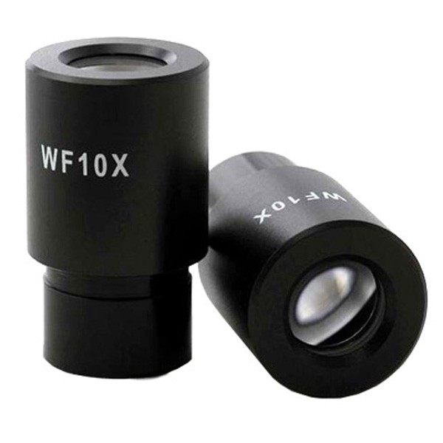
#1 Eye Piece

Slide 3
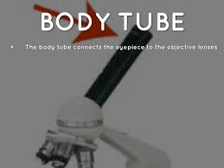
#2 Body Tube

Slide 4
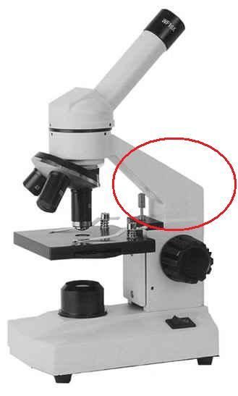
#3 Arm

Slide 5
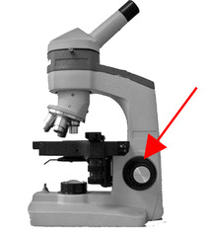
#4 Coarse Adjustment Knob

Slide 6
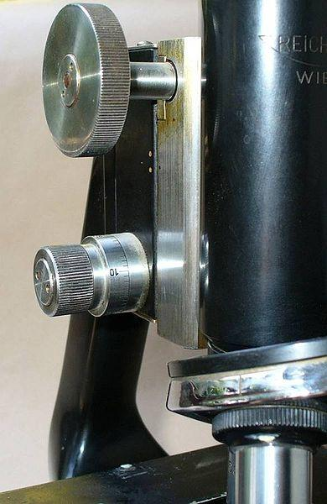
#5 Fine Adjustment Knob

Slide 7
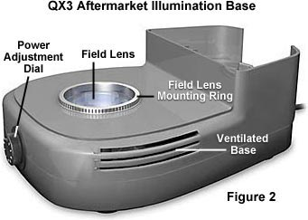
#6 Base

Slide 8
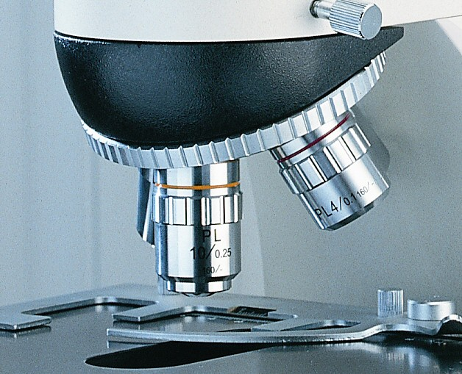
#7 Revolving Nose Piece

Slide 9
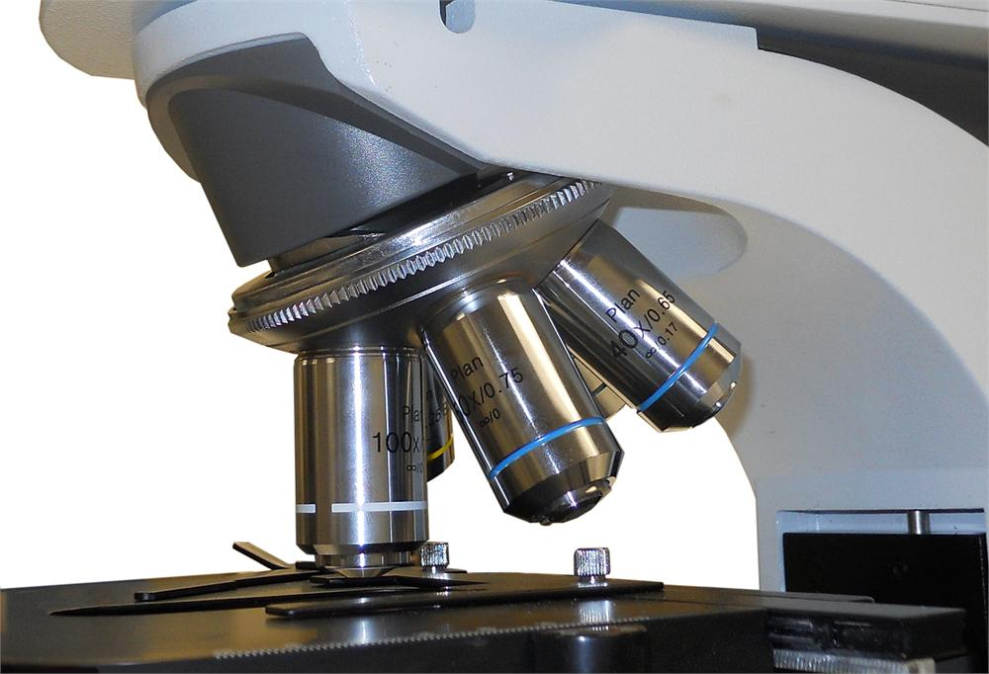
#8 Objective Lenses
Low: 4X
Medium: 10X
High: 40X

Slide 10
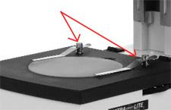
#9 Stage Clips

Slide 11
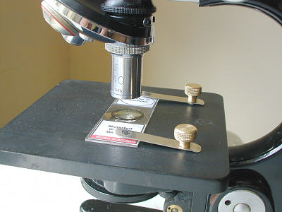
#10: Stage

Slide 12
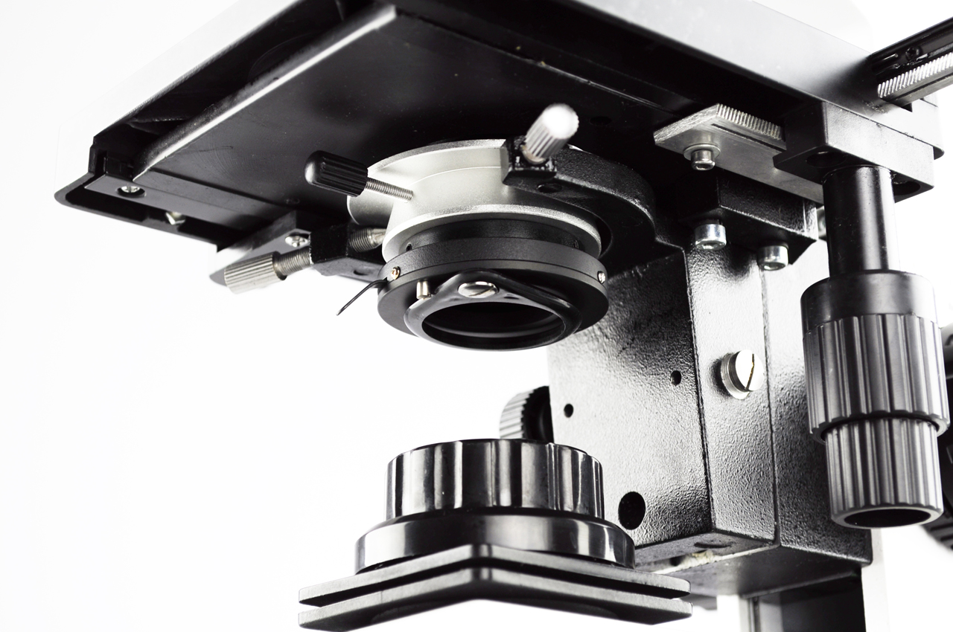
#11 Diaphragm
Lets light through

Slide 13
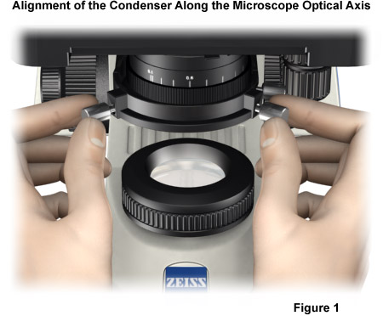
#12 Light Source
Lamp or Mirror

